Slide 1
Angle Analysis for SVA
Meilei Jiang
Department of Statistics and Operations Research
UNC-Chapel Hill

Slide 2
Review of Surrogate Variable Analysis
The overall goal of SVA is to provide a more accurate and reproducible parsing of signal and noise in the analysis of an expression study when Expression Heterogeneity (EH) is present.

Slide 3
Review of Surrogate Variable Analysis
Step 1: Detect the surrogate variable
Remove the signal due to the primary variable of interest to obtain a residual expression matrix.
Apply a decomposition to the residual expression matrix to identify signatures of EH.
Use a statistical test to determine the singular vectors that represent significantly more variation than would be expected by chance.

Slide 4
Review of Surrogate Variable Analysis
Step 2: Identify the subset of genes driving each orthogonal signature of EH.
Apply a significance analysis of associations between genes and the EH signatures on the residual matrix.

Slide 5
Review of Surrogate Variable Analysis
Step 3: For each subset of genes, build a surrogate variable based on the full EH signature of that subset in the original expression data.

Slide 6
Review of Surrogate Variable Analysis
Step 4: Include all significant surrogate variables as covariates in subsequent regression analysis.

Slide 7
Design of Simulation
High dimension low sample size setting:
80 samples in columns, 100 genes in rows
80 samples are associated with two classes:
40 samples are in Class 1
40 samples are in Class 2
Class Vector: y = (1_{n11}, 1_{n12}, 0_{n21}, 0_{n22})
80 samples are collected from two batches: Batch 1 and Batch 2
π₁ of samples in Class 1 are collected from Batch 1
π₂ of samples in Class 2 are collected from Batch 1
Batch Vector: bv = (1_{n11}, 0_{n12}, 1_{n21}, 0_{n22})
Note: n11 = π₁*40, n12 = 40 – n11; n21 = π₂*40, n22 = 40 – n21

Slide 8
Design of Simulation
Balance Design: π₁= π₂ = 0.5
Unbalance Design
Case I: π₁ = π₂, π₁ + π₂≠1
Batch vector and primary variable vector are uncorrelated.
Sizes of two batches are different.
Case II: π₁≠ π₂, π₁ + π₂ = 1
Batch vector and primary variable vector are correlated.
Sizes of two batches are the same.
Case III: π₁≠ π₂, π₁ + π₂ ≠1
Batch vector and primary variable vector are correlated.
Sizes of two batches are different.

Slide 9
Design of Simulation
Settings of genes for effects of primary variable and batch.
Type 1: Gene 1 – s1:
Primary variable effect + random noise
Type 2: Gene s1 + 1 – s2:
Primary variable effect + batch effect + random noise
Type 3: Gene s2 + 1 – s3:
batch effect + random noise
Type 4: Gene s3 + 1– s4:
random noise
The size of four types (t1, t2,t3, t4) = (20, 20, 20, 40)
40% genes are affected by primary variable.
40% genes are affected by batch.
20% genes are affected by both primary variable and batch.
40% genes are random noise.

Slide 10
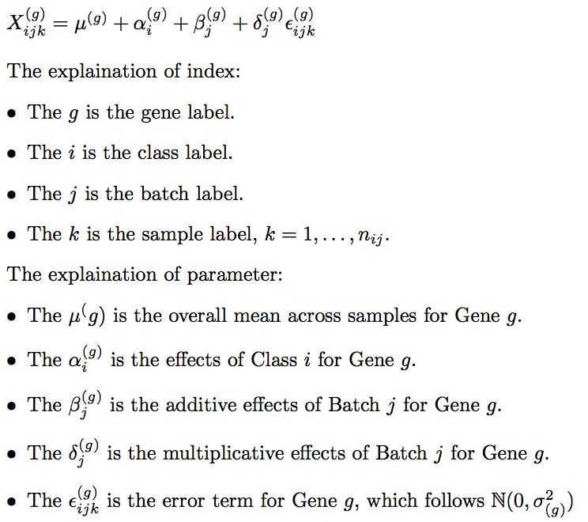
Location and Scale Batch Effect Model

Slide 11
Design of Simulation
Primary Variable Effect
Class 1: α₁ = 2
Class 2: α₂ = -2
Batch Effect:
Additive Effect
Batch 1: β₁ = 2
Batch 2: β₂ = -2
Multiplicative Effect
Batch 1: δ₁ = 1
Batch 2: δ₂ = 2
Random Noise
N(0 , 1)

Slide 12
Summary of Simulation: Additive Batch Effect
SVA works well in the balanced case.
The Unbalanced Design Case I will shift the estimation of class effects.
The Unbalanced Design Case II will amplify or shrink the difference between the two class effects.
SVA can identify the surrogate variable in the Unbalanced Design Case I but can not adjust the shift.
SVA may fail in the extreme cases of the Unbalanced Design Case II. SVA can adjust the bias caused by the Unbalanced Design Case II.

Slide 13
Summary of Simulation: Multiplicative Batch Effect
Multiplicative Batch Effect is heteroscedasticity.
The SVA will fail under this heterogeneity setting.

Slide 14
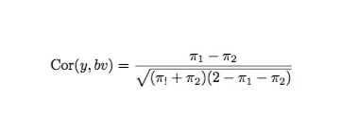
Angle Analysis: Y vs BV
Angle between batch vector and class vector:

Slide 15
Angle Analysis: Y vs BV

Slide 16
Angle Analysis: SVA vs BV

Slide 17
Comment: SVA vs BV
SVA can not detect BV at four corners:
(0,0) and (1,1): no batch effects
(1,0): Batch Effects and Class Effects are the same.
(0,1): Batch Effects and Class Effects are the opposite.
SVA is robust against Case I unbalanced additive batch effect.
SVA is not robust against Case II unbalanced additive batch effect.
The behavior of SVA along the line x + y = 1 is not continuous.
SVA performs better at the left upper corner than the right lower corner.

Slide 18
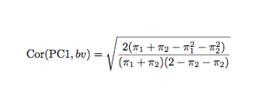
Angle Analysis: PC1 vs BV
Ignoring the random noise in the expression matrix:

Slide 19
Angle Analysis: PC1 vs BV (no noise In theory)

Slide 20
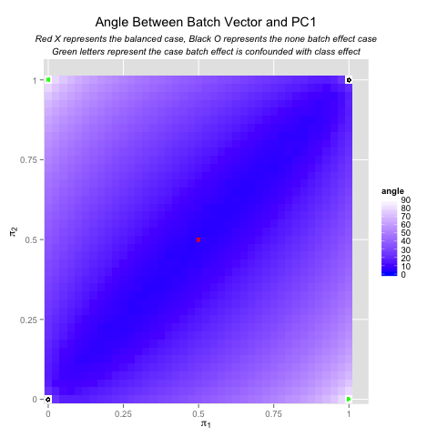
Angle Analysis: PC1 vs BV(simulation)

Slide 21
Comments: PC1 vs BV
PC1 is more robust to Case II unbalanced additive batch effects and less robust to Case I unbalanced additive batch effects than SVA.
The behavior of PC1 is continuous and symmetric with both the lines π₁ = π₂ and π₁ + π₂ = 1.

Slide 22
Angle Analysis: SV and PC1
SV is not directed constructed from PC1.
SV is the PC of reduced matrix in which the genes is correlated to PC1.

Slide 23
Angle Analysis: SV and PC1

Slide 24
Comparing SV and PC1

Slide 25
Angle Analysis: PC1 and X
X is the gene affected by both class effects and batch effects.
X is used to construct SV if cor(PC1, x) ≠ 0 significantly.

Slide 26
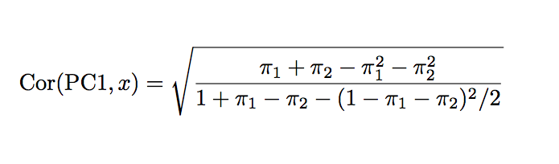
Angle Analysis: PC1 vs X (Without Noise In Theory)

Slide 27
Angle Analysis: PC1 vs X (Without Noise In Theory)

Slide 28
Angle Analysis: PC1 vs X (In Simulation)

Slide 29
Comment: PC1 vs X
PC1 has more correlation with X at the left upper corner.
This explains why the behavior of SVA is asymmetric about the line π₁ = π₂.

Slide 30
More details
Why the behavior of SVA is asymmetric along the line π₁ = π₂ ?
Visualize the vector in the row space along the line π₁ + π₂ =1.

Slide 31
Eg1. π₁ = 0.1, π₂ = 0.9

Slide 32
Eg1. π₁ = 0.1, π₂ = 0.9

Slide 33
Eg1. π₁ = 0.1, π₂ = 0.9

Slide 34
Eg2. π₁ = 0.5, π₂ = 0.5

Slide 35
Eg2. π₁ = 0.5, π₂ = 0.5

Slide 36
Eg2. π₁ = 0.5, π₂ = 0.5

Slide 37
Eg3. π₁ = 0.9, π₂ = 0.1

Slide 38
Eg3. π₁ = 0.9, π₂ = 0.1

Slide 39
Eg3. π₁ = 0.9, π₂ = 0.1

Slide 40
Summary
 |  | batch vector |  | surrogate variable
 | Noise | 1 | 0.01 | 1 | 0.01
PC1 | π1 = 0.1, π2 = 0.9 | 53.43 | 53.13 | 21.39 | 18.41
 | π1 = 0.5, π2 = 0.5 | 5.04 | 0.05 | 5.59 | 0.04
 | π1 = 0.9, π2 = 0.1 | 53.52 | 53.13 | 72.36 | 87.8

Slide 41
Summary
 |  | residual gene affected by batch & class |  | residual gene affected by batch
 | Noise | 1 | 0.01 | 1 | 0.01
PC1 | π1 = 0.1, π2 = 0.9 | 26.46 | 0.46 | 26.4 | 0.48
 | π1 = 0.5, π2 = 0.5 | 26.62 | 0.28 | 26.3 | 0.04
 | π1 = 0.9, π2 = 0.1 | 39.43 | 0.45 | 40 | 0.45

Slide 42
Summary
 |  | gene affected by batch & class |  | gene affected by batch
 | Noise | 1 | 0.01 | 1 | 0.01
PC1 | π1 = 0.1, π2 = 0.9 | 42.02 | 18.43 | 57.08 | 53.12
 | π1 = 0.5, π2 = 0.5 | 48.78 | 45 | 21 | 0.04
 | π1 = 0.9, π2 = 0.1 | 72.6 | 71.57 | 57.82 | 53.12

Slide 43
Local False Discovery Rate
A collection of null hypotheses:
H₁, H₂, …,H_{N}
Test statistics (not necessarily independent):
Y₁, Y₂, …, Y_{N}
Corresponding p-values:
P₁, P₂, …, P_{N}
Corresponding z-values:
z_{i} = Φ⁻¹(P_{i}), i = 1,2, …, N
z_{i}|H_{i} follows N(0, 1)
Theoretical null hypothesis

Slide 44
Local False Discovery Rate
Assume that z_{i} has density either f₀(z) or f₁(z), depending on its class.
p₀ = Pr{Uninteresting}, f₀(z) density if Uninteresting(Null)
p₁ = Pr{Interesting}, f₁(z) density if Interesting(Nonnull)
Mixture density of z-values
f(z) = p₀f₀(z) + p₁f₁(z)
local false discovery rate
Pr{Uninteresting|z} = p₀ fdr(z) = p₀f₀(z)/f(z)

